Slide 1

Team ZeroFLOPs
presents

Slide 2
The problem
Hours spent on internet in a day
Our internet presence is increasingly consuming a chunk of our daytime.
Majority of that time eaten up by social media.
This implies less physical activity, which further implies health problems
This is when Facebook was open to all.
- 2001 | 2001-06 | 2006-2012 | 2012-18

Slide 3

The solution
Combine ‘Social Networking’ with a healthy and enjoyable activity
-> DANCING

Slide 4
Allows you to share your moves in form of an avatar. For instance you can make Thanos do a Bhangra.
Compete with other people.
Learn dance moves generated on any given songs through machine learning.
A platform for sharing your animated dancing avatars.

Slide 5
Application Structure

Slide 6
COMPETE
RANK
LEARN

Slide 7
Compete
We extract keypoints of your body using a Deep Neural Network called PoseNet.
Using the extracted points we map the motion onto a 3D mesh using quaternion algebra and WebGL.
Record your dance move ..
Our AI will map your moves to.

Slide 8
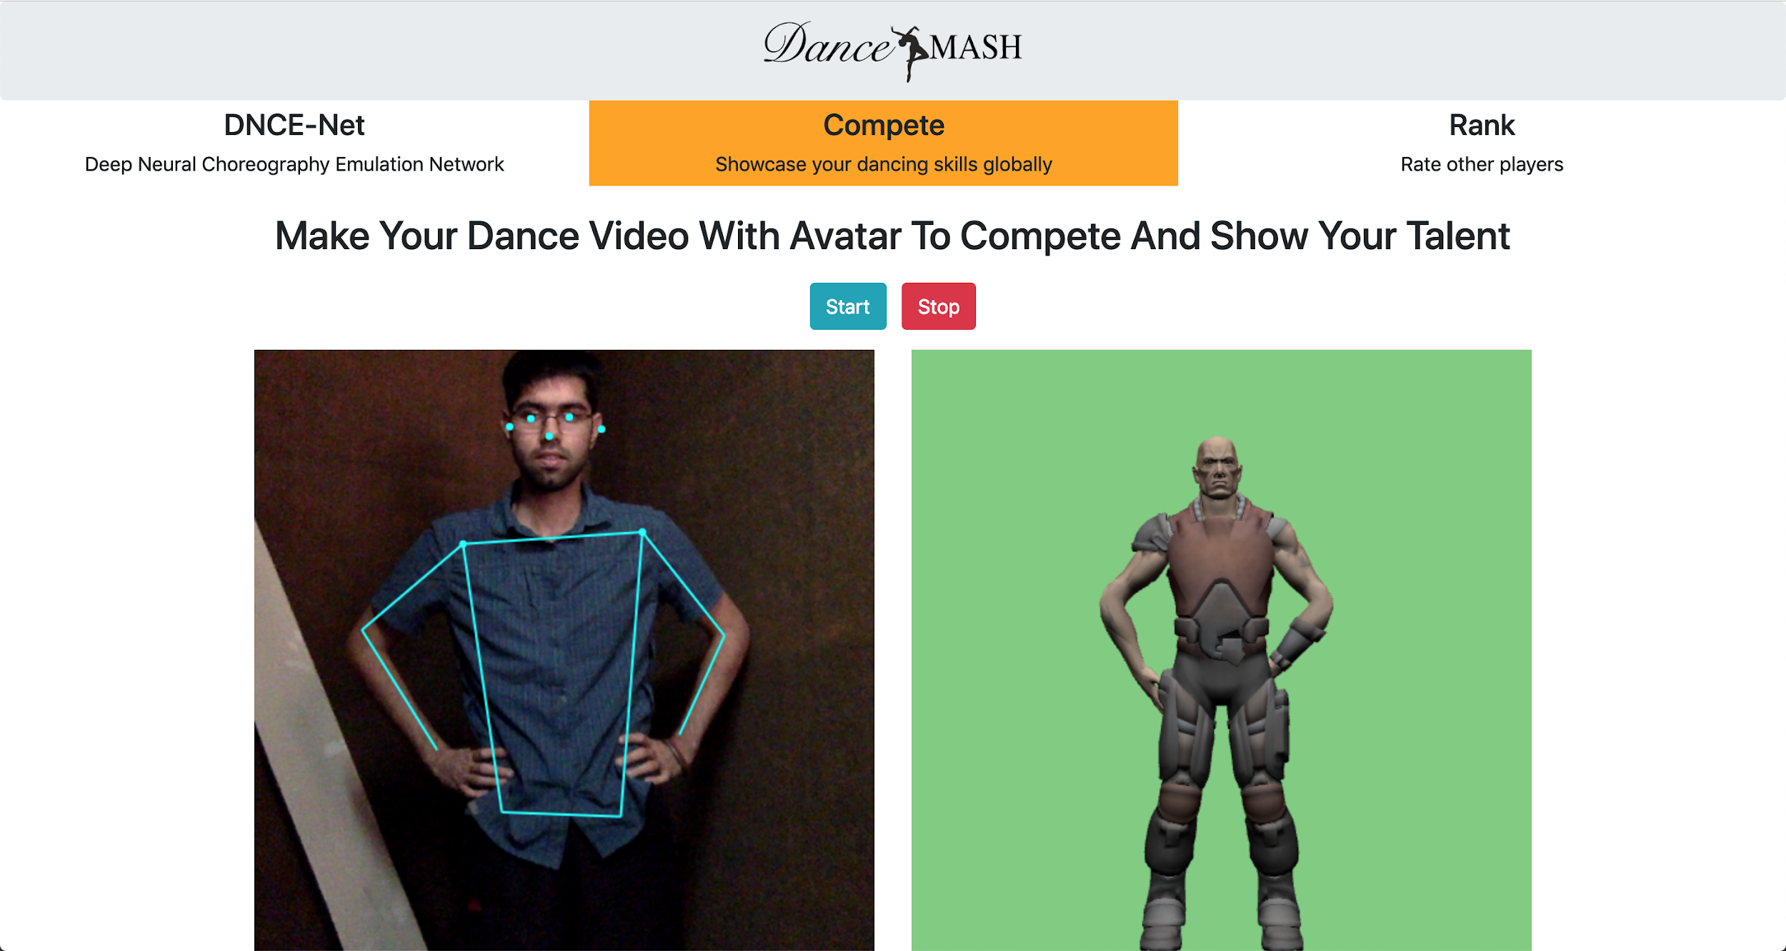

Slide 9
Rank
You will be given to dance clips to judge.
You have got to rate one of them up.
The dance clips of other users

Slide 10
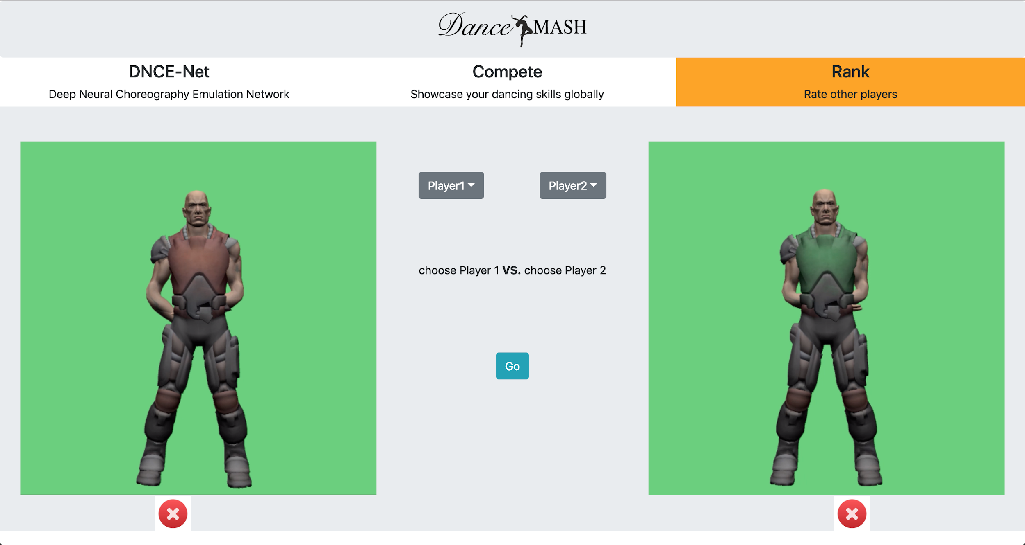

Slide 11
Learn
Just select a song, and on the basis of waveform features and lyrics, the avatar would show some dance moves.
Did this by training an RNN on song lyrics which tries to generate body keypoints. We call it DNCE-Net (Deep Neural Choreography Emulation NETwork)
Provide a song, our Neural Network would generate the apt dance moves for you!!

Slide 12
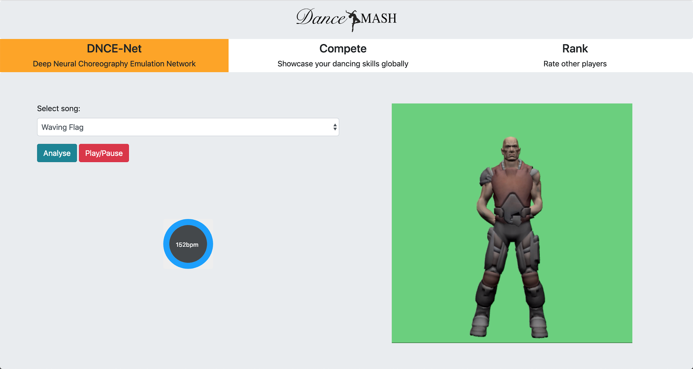

Slide 13
Other possible use cases and Future Work
Once the network is trained with sufficient data and compute, the model can be used to augment traditional choreography.
The algorithm we used for detecting keypoints and mapping them onto 3D avatars can be used for simplifying production of animated movies.
We also wanted to add group dancing feature but couldn’t do it due to time constraints.

Slide 14
The team
The people who fumbled around making this project
Nilay Shrivastava
Astitwa Saxena
Rashmeet Kaur
Kush Misra
NSIT
NSIT
NSIT
NSIT

